Slide 1
Animal Classification Analysis
By:- Rupali Gawate

Slide 2
Introduction
Animal image classification is a complex task that involves using artificial intelligence (AI) algorithms to identify and categorize animals based on their visual characteristics.
With the advent of deep learning and computer vision technologies, it is now possible to develop highly accurate and efficient animal image classification systems that can analyze millions of images in real-time.
One of the primary challenges in animal image classification is dealing with the vast amount of visual data that is available. This data can be highly diverse, ranging from low-quality camera trap images to high-resolution photos captured by professional photographers.
Additionally, the appearance of animals can vary significantly depending on factors such as age, sex, and location. To overcome these challenges, researchers often rely on deep learning models that can learn from large datasets and generalize well to new images.

Slide 3
Another important consideration in animal image classification is the ethical implications of this technology.
While AI-powered wildlife monitoring systems have the potential to revolutionize conservation efforts, they also raise concerns about privacy, data security, and animal welfare.
It is crucial for researchers and developers to prioritize ethical considerations and collaborate with stakeholders such as conservationists, animal rights groups, and indigenous communities to ensure that these systems are used responsibly and for the greater good.

Slide 4
Import Necessary Libraries
# Import Data Science Libraries
import numpy as np
import pandas as pd
import tensorflow as tf
from sklearn.model_selection import train_test_split
import itertools
import random
import os.path
from pathlib import Path

Slide 5
Load and Transform Data
# Walk through each directory
dataset = r"C:\Users\rupsy\OneDrive\Desktop\Internship Projects\Projects-20240722T093004Z-001\Projects\animal_classification\Animal Classification\dataset"
walk_through_dir(dataset)
I have load the data to get the images to read properaly.
After reading the images I have convert path to dataframe to do all EDA and visualizations.
def convert_path_to_df(dataset):
image_dir = Path(dataset)
# Get filepaths and labels
filepaths = list(image_dir.glob(r'**/*.JPG')) + list(image_dir.glob(r'**/*.jpg')) + list(image_dir.glob(r'**/*.jpeg')) + list(image_dir.glob(r'**/*.PNG'))
labels = list(map(lambda x: os.path.split(os.path.split(x)[0])[1], filepaths))
filepaths = pd.Series(filepaths, name='Filepath').astype(str)
labels = pd.Series(labels, name='Label')
# Concatenate filepaths and labels
image_df = pd.concat([filepaths, labels], axis=1)
return image_df
image_df = convert_path_to_df(dataset)

Slide 6
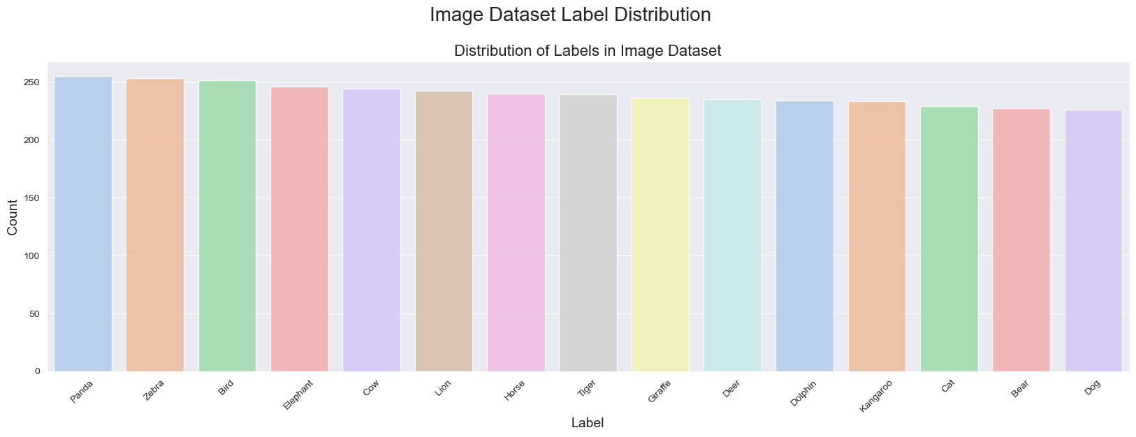

Slide 7
The above bar chart is showing the count of images that which animals images are there present in dataset . For example from above we can conclude that Panda have maximum images in the dataset. And dog has the less number of images in the dataset. The first column filepaths contains the file path location of each individual images. The second column labels, on the other hand, contains the class label of the corresponding image from the file path

Slide 8
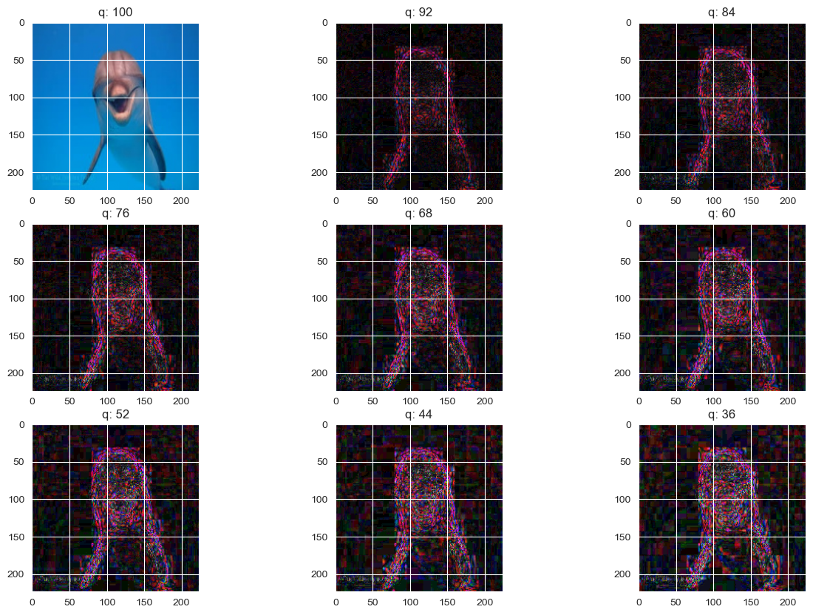
Visualizing images from the dataset

Slide 9
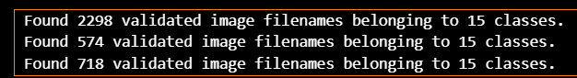
I got the above images randomly. If you iterate every time you will get different animals randomly whichever present in the dataset.
After that you have to train and test the data for predictions to get accuracy. And I have got the following answer.
Found 2298 validated image filenames belonging to 15 classes. Found 574 validated image filenames und 5 validated image filenames belonging to 15 classes. Found 718 validated image filenames belonging to 15 classes. ng to 15 classes. Found 718 validated image filenames belonging to 15 classes.

Slide 10
Training the model
The model images will be subjected to a pre-trained CNN model called EfficientNetB7. Three callbacks will be utilized to monitor the training. These are: Model Checkpoint, Early Stopping, Tensorboard callback. The summary of the model hyperparameter is shown as follows:
Batch size: 32 Epochs: 5 Input Shape: (224, 224, 3) Output layer: 10
I have taken here only 5 epochs because of time taken to load data as in this dataset I have large data. And because of that my accuracy comes less. If you want increase accuracy you can increase your eppochs to 50 or 100. It will give you 99% of accuracy.

Slide 11
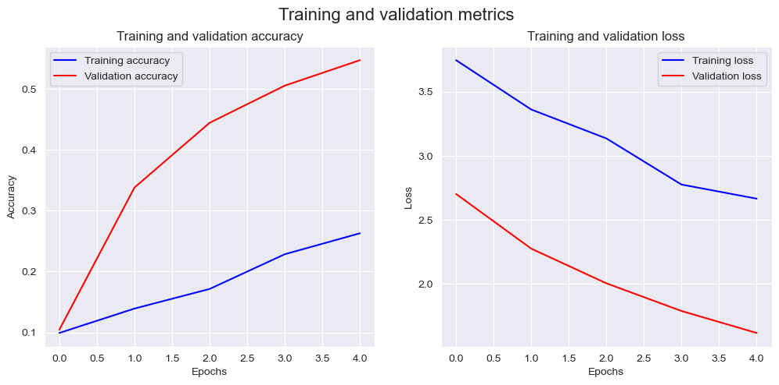
Visualizing loss curves:

Slide 12
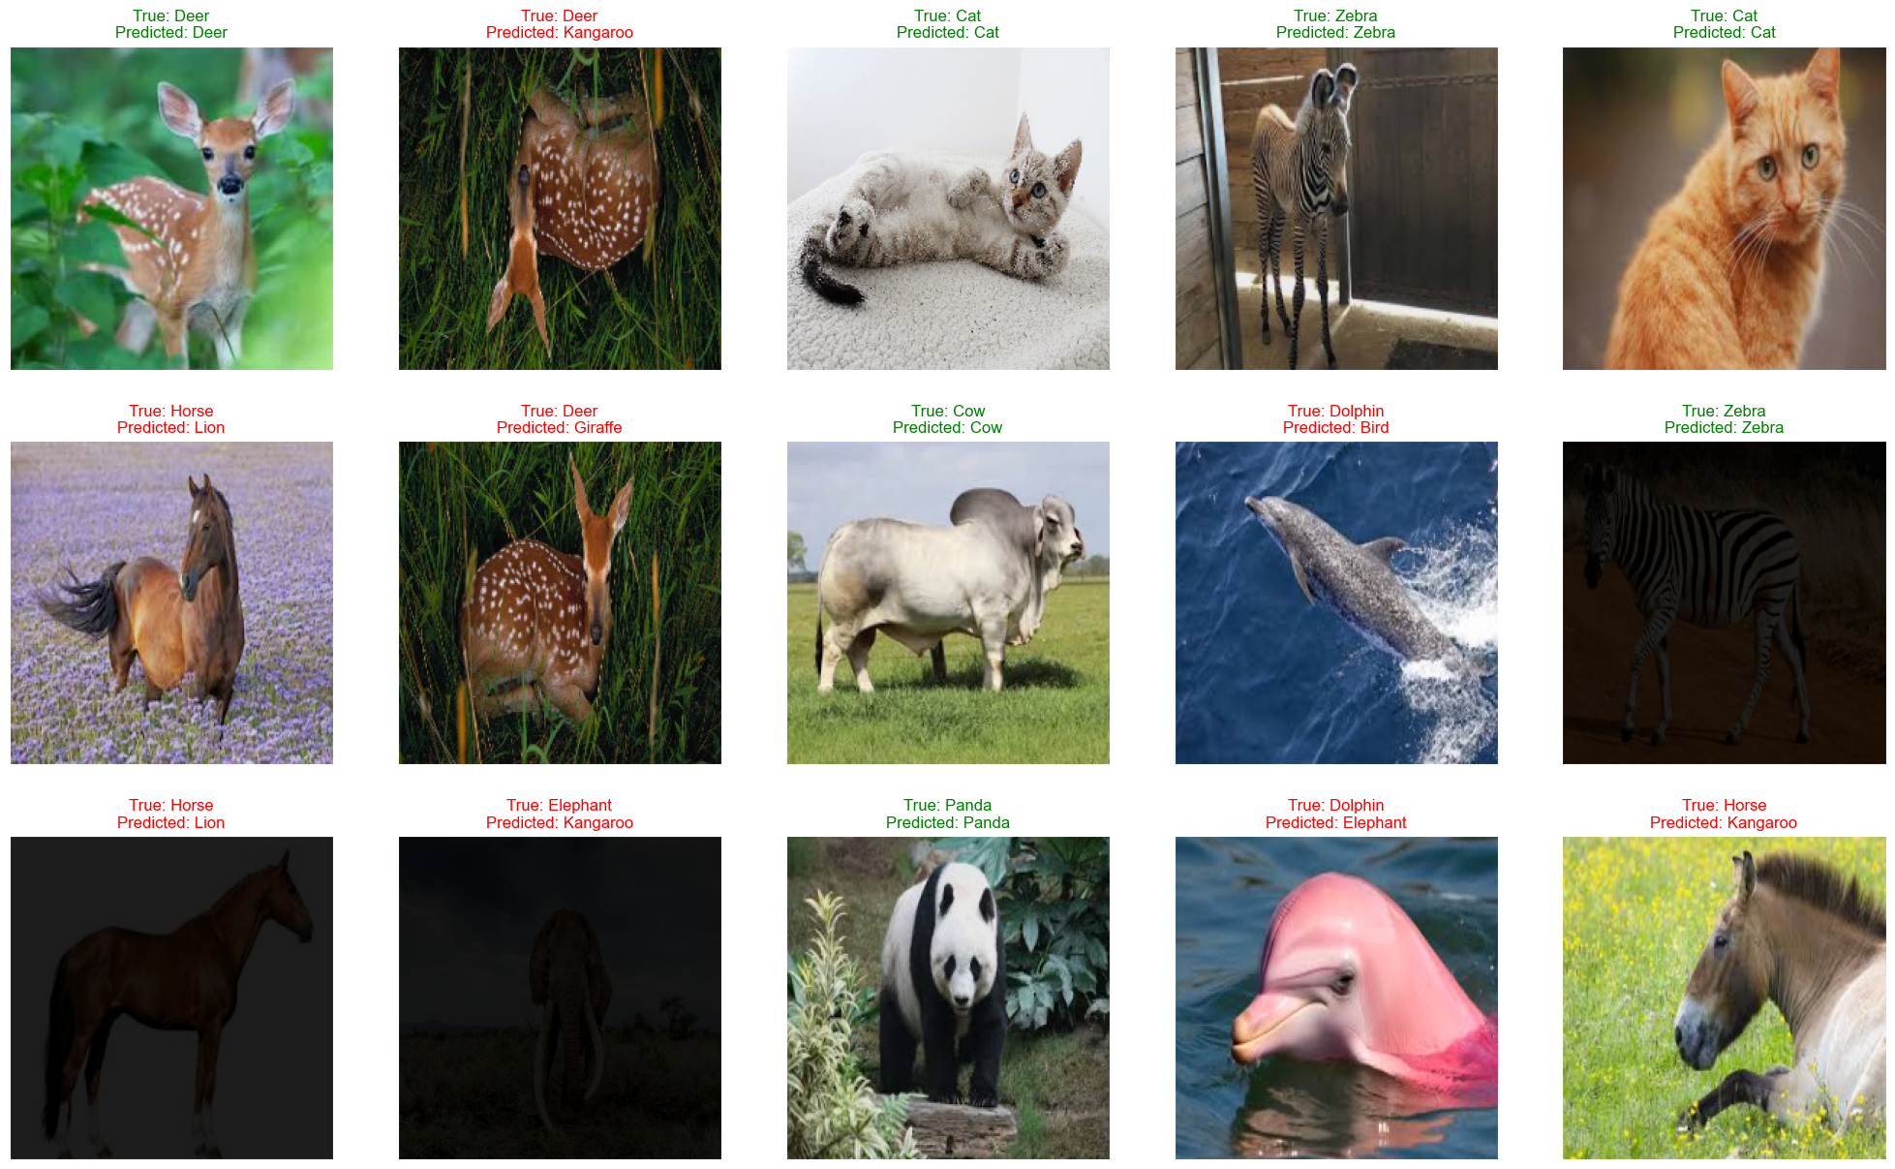
Display 25 random pictures from the dataset with their labels

Slide 13
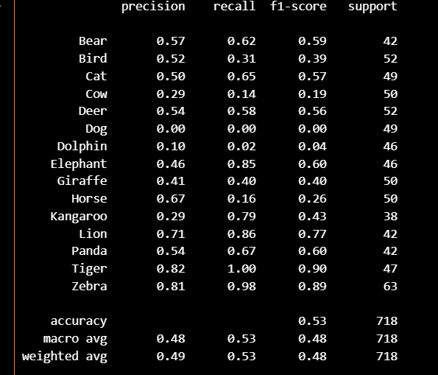
Separate in train and test data train_df, test_df = train_test_split(image_df, test_size=0.2, shuffle=True, random_state=42)

Slide 14
report = classification_report(y_test, pred, output_dict=True) df = pd.DataFrame(report).transpose() df
precision | recall | f1-score | support
Bear | 0.565217 | 0.619048 | 0.590909 | 42.000000
Bird | 0.516129 | 0.307692 | 0.385542 | 52.000000
Cat | 0.500000 | 0.653061 | 0.566372 | 49.000000
Cow | 0.291667 | 0.140000 | 0.189189 | 50.000000
Deer | 0.535714 | 0.576923 | 0.555556 | 52.000000
Dog | 0.000000 | 0.000000 | 0.000000 | 49.000000
Dolphin | 0.100000 | 0.021739 | 0.035714 | 46.000000
Elephant | 0.458824 | 0.847826 | 0.595420 | 46.000000
Giraffe | 0.408163 | 0.400000 | 0.404040 | 50.000000
Horse | 0.666667 | 0.160000 | 0.258065 | 50.000000
Kangaroo | 0.291262 | 0.789474 | 0.425532 | 38.000000
Lion | 0.705882 | 0.857143 | 0.774194 | 42.000000
Panda | 0.538462 | 0.666667 | 0.595745 | 42.000000
Tiger | 0.824561 | 1.000000 | 0.903846 | 47.000000
Zebra | 0.805195 | 0.984127 | 0.885714 | 63.000000
accuracy | 0.532033 | 0.532033 | 0.532033 | 0.532033
macro avg | 0.480516 | 0.534913 | 0.477722 | 718.000000
weighted avg | 0.487156 | 0.532033 | 0.480631 | 718.000000

Slide 15
Plotting the Classification Reports and Confusion Matrix
Confusion matrix and classification report are two important tools used for evaluating the performance of an image classification model.
A confusion matrix is a table that summarizes the number of correct and incorrect predictions made by a classification model on a set of test data. It is usually represented as a square matrix with rows and columns representing the predicted and true class labels, respectively. The entries of the matrix indicate the number of test samples that belong to a certain class, and how many of those were classified correctly or incorrectly by the model. A confusion matrix can provide a detailed breakdown of the performance of the model, including measures such as accuracy, precision, recall, and F1-score for each class. It can be used to identify specific areas where the model is making errors, and to diagnose problems with the model's predictions.
A classification report is a summary of the key performance metrics for a classification model, including precision, recall, and F1-score, as well as the overall accuracy of the model. It provides a concise overview of the model's performance, typically broken down by class, and can be used to quickly assess the strengths and weaknesses of the model. The report is often presented as a table, with each row representing a class and columns showing various performance metrics. The report may also include other metrics such as support (the number of test samples belonging to a particular class), and the macro- and micro-averages of the performance metrics across all classes.
In image classification, both confusion matrix and classification report are important tools for evaluating the performance of the model, identifying areas for improvement, and making decisions about how to adjust the model's architecture or training parameters.

Slide 16
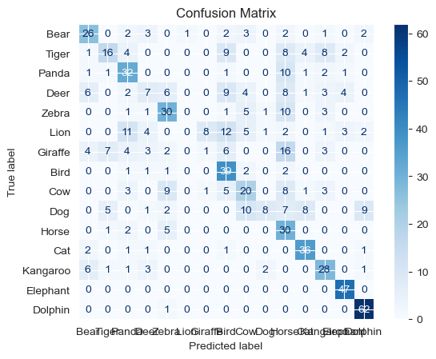
disp = ConfusionMatrixDisplay(confusion_matrix=cm, display_labels=list(set(y_test))) disp.plot(cmap=plt.cm.Blues) plt.title('Confusion Matrix') plt.show()

Slide 17
Grad-Cam Visualization
Grad-CAM (Gradient-weighted Class Activation Mapping) is a technique used to visualize the regions of an input image that were most relevant for a neural network's prediction. It allows you to see which regions of the image the model focused on while making its prediction. Grad-CAM is a modification of the CAM technique that extends the latter to any model that uses a convolutional neural network (CNN) as its underlying architecture.

Slide 18
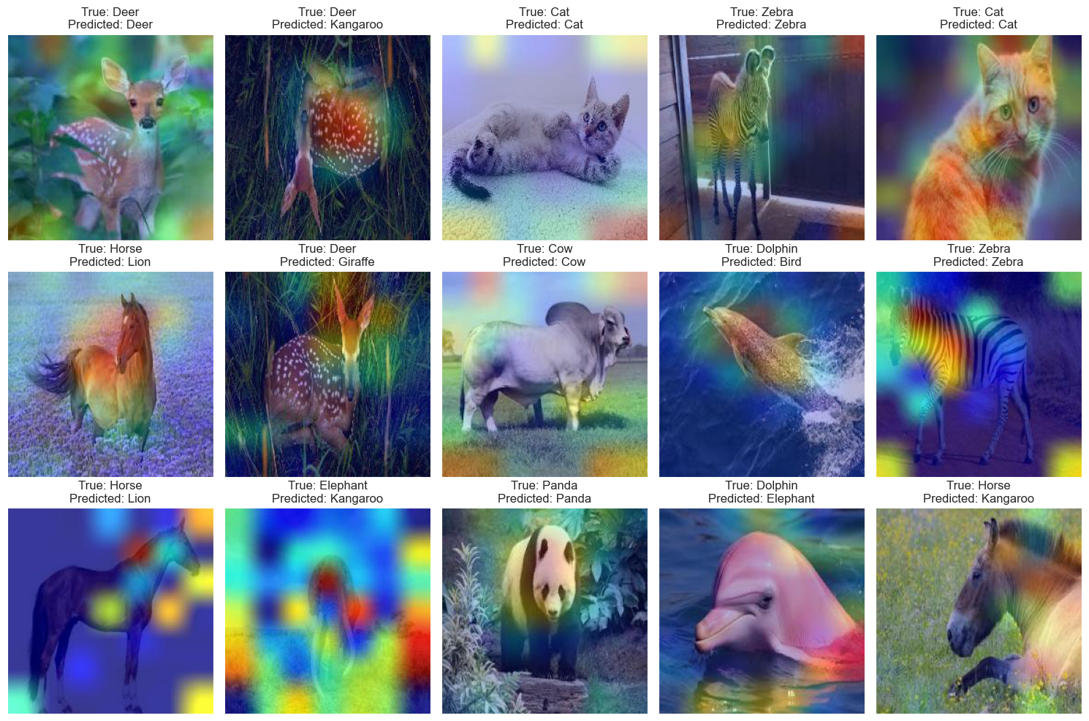
These are the some of pictures that I have got after the grad cam visualization.

